Slide 1
Introduction to Solid Breeders
MAE 237D Winter 2016
UCLA
JTVL

Slide 2
Solid Breeder Material Technology

Slide 3
Why are we interested in solid breeder concepts?
Safety advantages of solid breeders
Low tritium mobility
Low stored chemical energy
Solid breeder materials narrowed down to ternary oxides of lithium
Li₂TiO₃, Li₄SiO₄, Li₂ZrO₃
Oxides have desirable characteristics
High lithium densities
High melting temperatures
Good tritium release
Good thermophysical/thermochemical
Desirable neutronics

Slide 4
Material Requirements
Neutronics
Thermochemical Properties
Tritium Release
Physical/Thermo-physical Properties
Compatibility
Radiation Effects
Fabrication

Slide 5
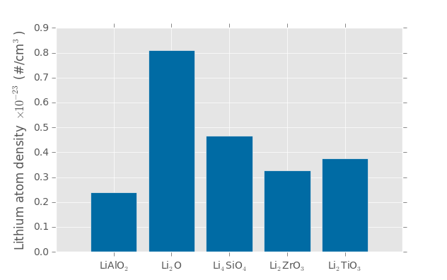
Neutronics
Functional requirement of tritium breeding is among the most critical
Oxide material can not interfere with the ability to capture neutrons
Neutron multiplication a necessity for all but lithium oxide

Slide 6
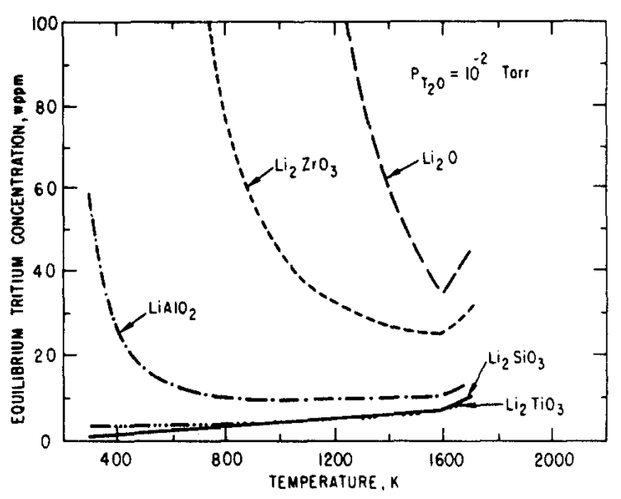
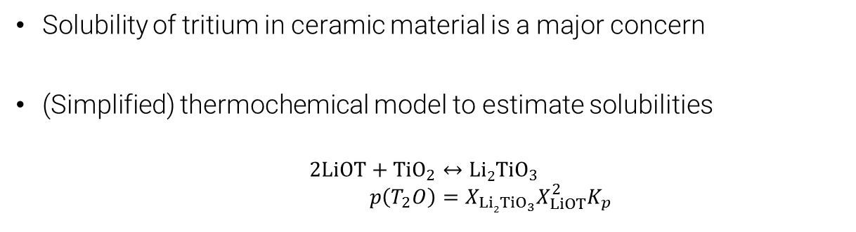
Thermochemical Properties: Solubility Calculations
Solubility of tritium in ceramic material is a major concern
(Simplified) thermochemical model to estimate solubilities
$$2LiOT+TiO_{2}↔Li2TiO_{3} \\ p\left(T_{2}O\right)=X_{Li2TiO_{3}}X_{LiOT}^{2}K_{p}$$
Very high solubility
Good solubility characteristics

Slide 7
Stoichiometry after Li-burnup
Lithium in ceramics is slowly transmuted into tritium
Stoichiometry and kinematics of ceramics in lithium-depleted materials has great uncertainty
e.g. LiAl₅O₈ is more stable than Al₂O₃
Free energy changes and K_{p} values overestimated
Eutectic temperatures often much lower than melt temperatures
e.g. Li₄SiO₄ ceramics develop an excess of silica, max temperature 1300 C drops to 1024 C

Slide 8
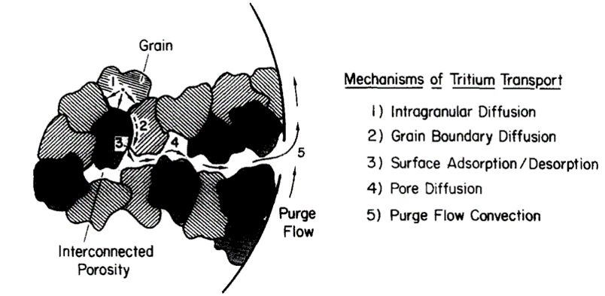
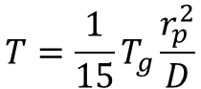
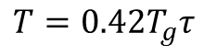
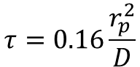
Tritium Release
Mechanistic steps of tritium release
Bulk diffusion
Grain boundary migration
Desorption of tritium (T₂O)
Percolation of tritium through pores internal to the solid ceramic toward purge gas
Convective mass transfer out of blanket via purge channels
Residency time measured in experiments
Inventory related to measured residency time
Diffusion of sphere, radius r_{p}:
$$T=\frac{1}{15}T_{g}\frac{r_{p}^{2}}{D}$$
$$τ=0.16\frac{r_{p}^{2}}{D}$$
$$T=0.42T_{g}τ$$
High uncertainty

Slide 9
Minimum Temperature for Solid Breeders
Residence times measured to be temperature dependent (consistent with diffusion-controlled processes)
Define minimum temperature such that inventory will not exceed 1kg/GW

Slide 10
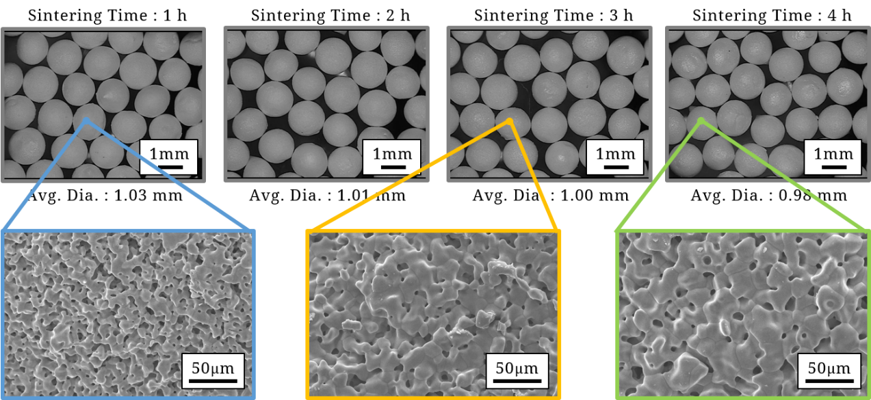
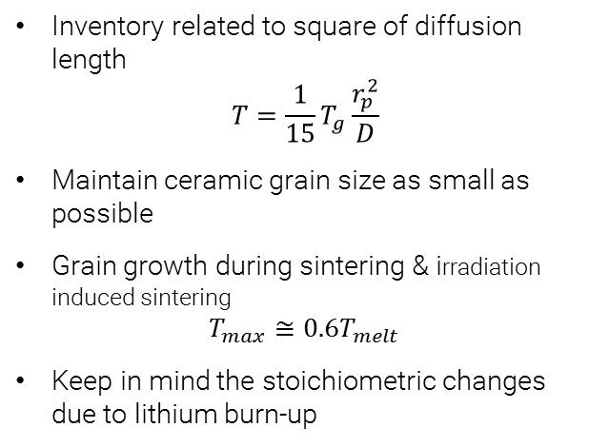
Maximum Temperature for Solid Breeders
Inventory related to square of diffusion length
$$T=\frac{1}{15}T_{g}\frac{r_{p}^{2}}{D}$$
Maintain ceramic grain size as small as possible
Grain growth during sintering & irradiation induced sintering
$$T_{max}≅0.6T_{melt}$$
Keep in mind the stoichiometric changes due to lithium burn-up

Slide 11
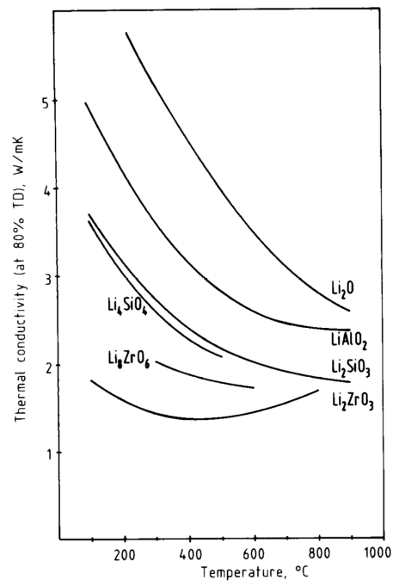
Physical/Thermo-physical Properties
Thermal conductivity a major factor – removing large nuclear heat loads
Elastic moduli a reflection of atomic bond strength
Qualitative information on lattice defects
Irradiation of LiAlO₂ (10²⁰ n/cm²)
400 C, no change
600 C, 10% reduction
Compressive strength not sensitive up to 2% at.% burn-up of lithium

Slide 12
Compatibility
Main concern is corrosion and tritium entrapment
Ternary oxides (Li₂TiO₃, Li₄SiO₄, etc.) relatively unreactive to structural materials
LiO, in the presence of any moisture, highly corrosive
Compatibility with neutron multiplier
BeO layer slows the diffusion of T out of Be, increasing inventory
Beryllides (e.g. Be₁₂Ti) allow possibility of mixed volumes of breeder & multiplier

Slide 13
Radiation Effects – Radiation Damage
Neutron capture of ⁶Li results in…
2 large gas atom production
Lithium vacancy
Several anticipated radiation damage mechanisms:
Displacement damage
Vacancies
Loops, clusters, etc.
Interstitials
Heat transfer in ceramics depends on phonon transport along lattices
Phonon scattering at defect sites will disrupt heat transfer
Though up to ITER-relevant fluence (~10²⁴ n/m²), no significant reduction has been seen in some ceramics

Slide 14
Danger of Daughter Nuclides
Selling point of fusion is environmentally benign impact
Choice of ceramic material must not abandon this ideal
Long-lived daughter nuclides should be avoided
Materials should meet requirements for near-surface burial as radioactive waste
Li₂TiO₃ and Li₄SiO₄ are most attractive from this perspective

Slide 15
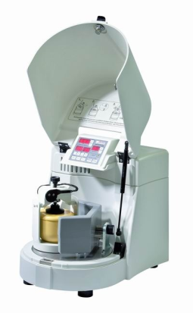
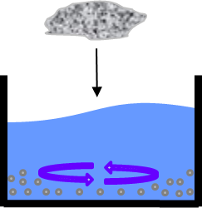
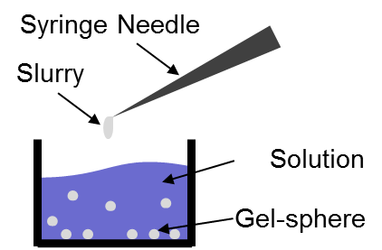
Fabrication
Example of wet-slurry droplet technique from NFRI
Fabrication Process
Li₂TiO₃ Powder
PVA Solution
Li₂TiO₃ Powder
Mixing
Mixing
PVA Solution
Dropping into Glycerin
including Boric Acid
Shaping
Drying
Sintering
Sintering
Any feasible technique must be able to scale to industrial production

Slide 16
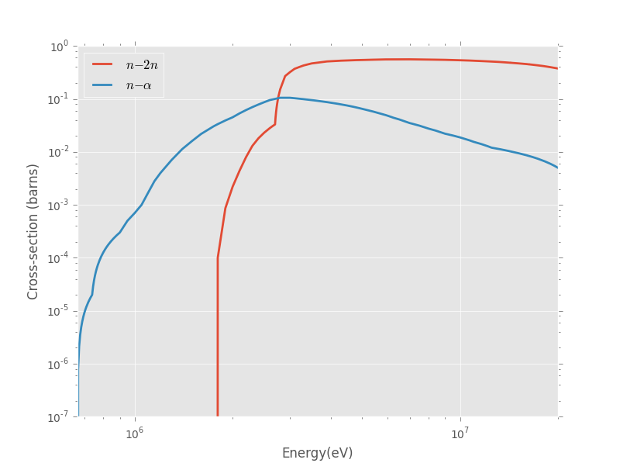
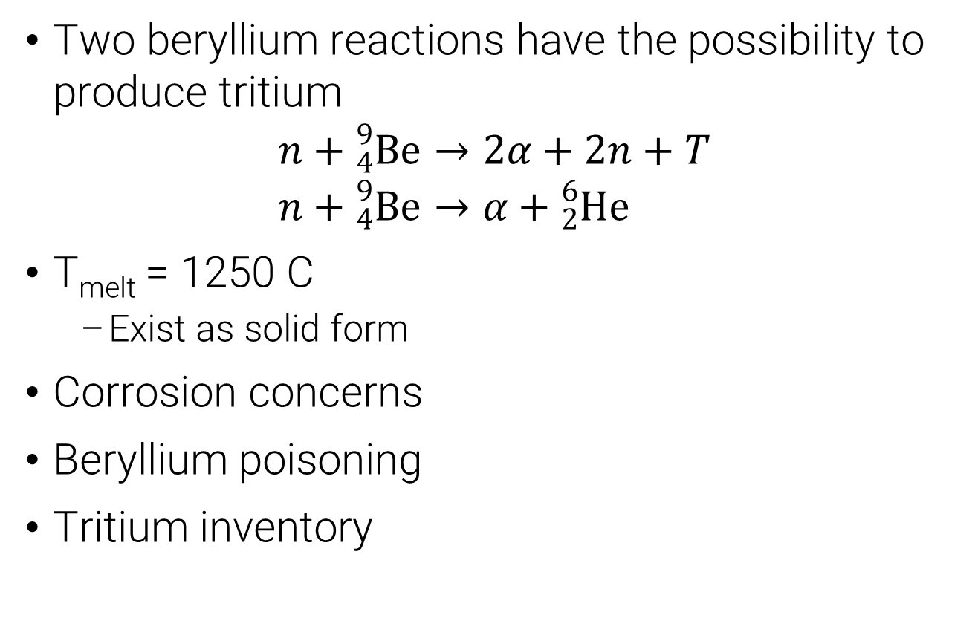
Neutron Multiplication in Solid Breeders
Two beryllium reactions have the possibility to produce tritium
$$n+{}_{4}^{9}{Be}→2α+2n+T \\ n+{}_{4}^{9}{Be}→α+{}_{2}^{6}{He}$$
T_{melt} = 1250 C
Exist as solid form
Corrosion concerns
Beryllium poisoning
Tritium inventory

Slide 17
Novel neutron multiplication options
More advantages of Be₁₂Ti
More compatible with steel than Be
Less swelling than Be
T inventory is significantly lower than Be
High Be density maintains n multiplication
Option for mixing with ceramic material

Slide 18
Introduction to Solid Breeder Analysis
Solid Breeder Thermal Management and Temperature Window
Purge Gas & Coolant
Phenomenological Models of Packed Beds
Continuum Modeling of Packed Beds
Discrete Element Modeling of Packed Beds

Slide 19
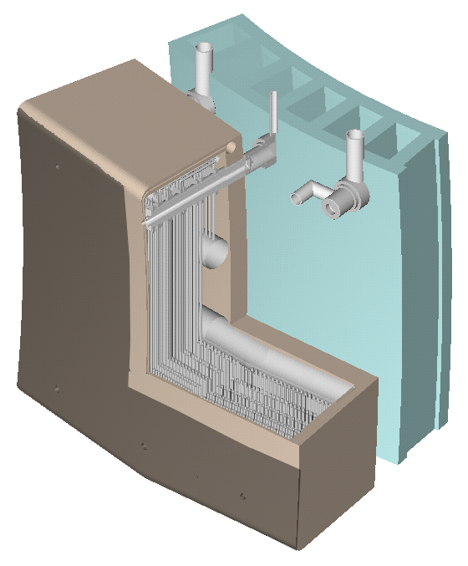
Example Japanese solid breeder
Purge gas
Coolant flow

Slide 20
Why we need such precision on thermal management?
Breeding blankets experience high volumetric heating from fusion neutrons (and secondary γ-rays)
Long heat path from generation to coolant in SB
Heat conducted through bed (poorly) toward container
HT through interface with container (dependent on good contact)
Purge gas will not help as coolant
Coupling between mechanical and thermal loads due to contact conductance of granular media

Slide 21
Why we need such precision on thermal management?
Large thermal and mechanical stresses on beds…
Cracking/crushing of individual pebbles
Inter-particle creep/necking
Sintering in hot spots
Tritium inventory & diffusion concerns dictate a narrow operational temperature window
Models must precisely predict thermomechanical interactions to allow tritium release with higher power density

Slide 22
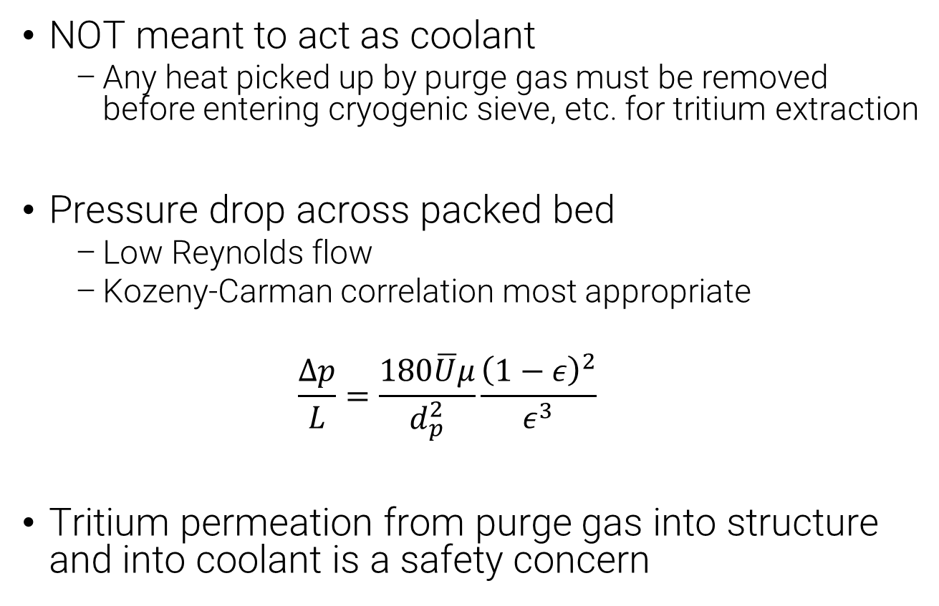
Purge Gas – Tritium extraction
NOT meant to act as coolant
Any heat picked up by purge gas must be removed before entering cryogenic sieve, etc. for tritium extraction
Pressure drop across packed bed
Low Reynolds flow
Kozeny-Carman correlation most appropriate
$$\frac{Δp}{L}=\frac{180\overline{U}μ}{d_{p}^{2}}\frac{{\left(1−ε\right)}^{2}}{ε^{3}}$$
Tritium permeation from purge gas into structure and into coolant is a safety concern

Slide 23
Coolant
Requirements
Must maintain containment below structural limits (~650 C for steel)
Must move high quality heat into power extraction cycle
High pressure helium or water (reactivity with LiO a concern)
Uniform flow partitioning is a design challenge

Slide 24
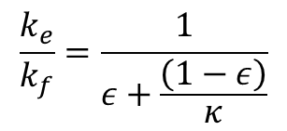
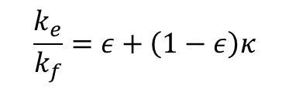
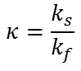
Phenomenological Models of Heat Transfer
Heat transfer through two phases of solid and fluid
First historical treatment began with limiting cases
Maximum heat transfer in parallel
Minimum in series
Parallel
Series
T_{H}
Solid
Fluid
Solid
Fluid
T_{L}
$$\frac{k_{e}}{k_{f}}=ε+\left(1−ε\right)κ$$
$$\frac{k_{e}}{k_{f}}=\frac{1}{ε+\frac{\left(1−ε\right)}{κ}}$$
$$κ=\frac{k_{s}}{k_{f}}$$

Slide 25
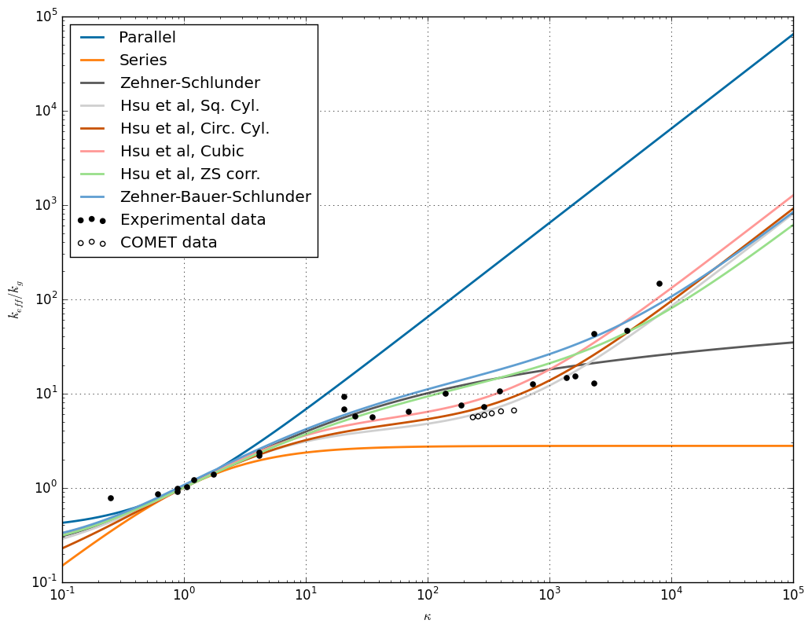
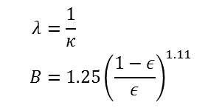
Effective conductivity models
Zehner and Schlunder introduced a model in 1970 considering a unit cell and empirically fit to data
Modified later with Bauer to include radiation effects
Become de-facto correlation for first order calculation in packed beds
Uncompressed pebble beds
$$\frac{k_{e}}{k_{f}}=\left[1−\sqrt{1−ε}\right]+\frac{2\sqrt{1−ε}}{1−λB}\left[\frac{\left(1−λ\right)B}{{\left(1−λB\right)}^{2}}\ln\left(\frac{1}{λB}\right)−\frac{B+1}{2}−\frac{B−1}{1−λB}\right]$$
$$λ=\frac{1}{κ} \\ B={1.25\left(\frac{1−ε}{ε}\right)}^{1.11}$$

Slide 26
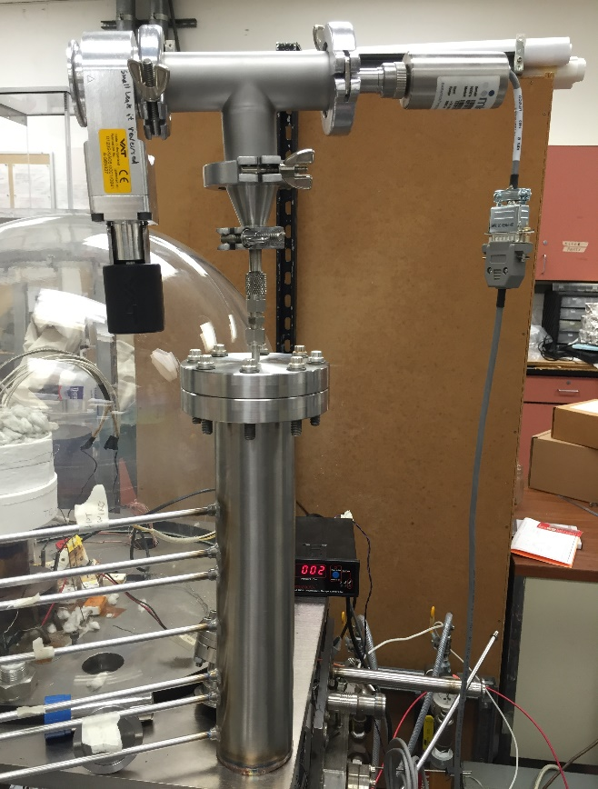
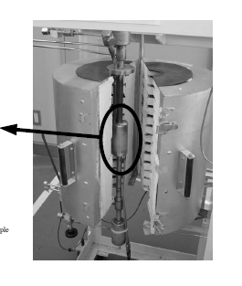
Direct measurements of k_{eff} with transient hot wire technique
Reliable technique for measuring effective conductivity of granular materials
Pulse of current
Thermocouples
Chris’s setup at UCLA

Slide 27
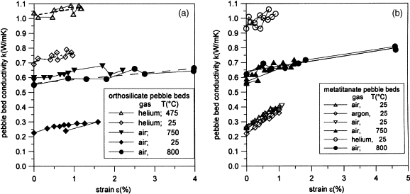
Effective conductivity weakly a function of strain
Indicative of granular conductivity a function of contact pressures
Li₄SiO₄
Li₂TiO₃

Slide 28
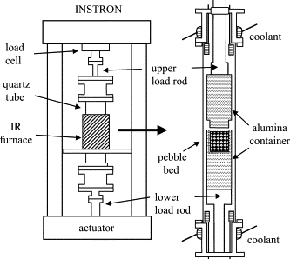
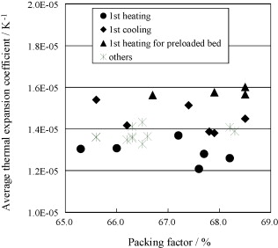
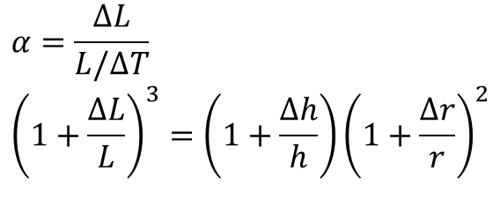
Effective thermal expansion
Li₂TiO₃
$$α=\frac{ΔL}{L/ΔT} \\ {\left(1+\frac{ΔL}{L}\right)}^{3}=\left(1+\frac{Δh}{h}\right){\left(1+\frac{Δr}{r}\right)}^{2}$$
Roughly 80% of the bulk value

Slide 29
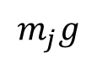
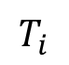
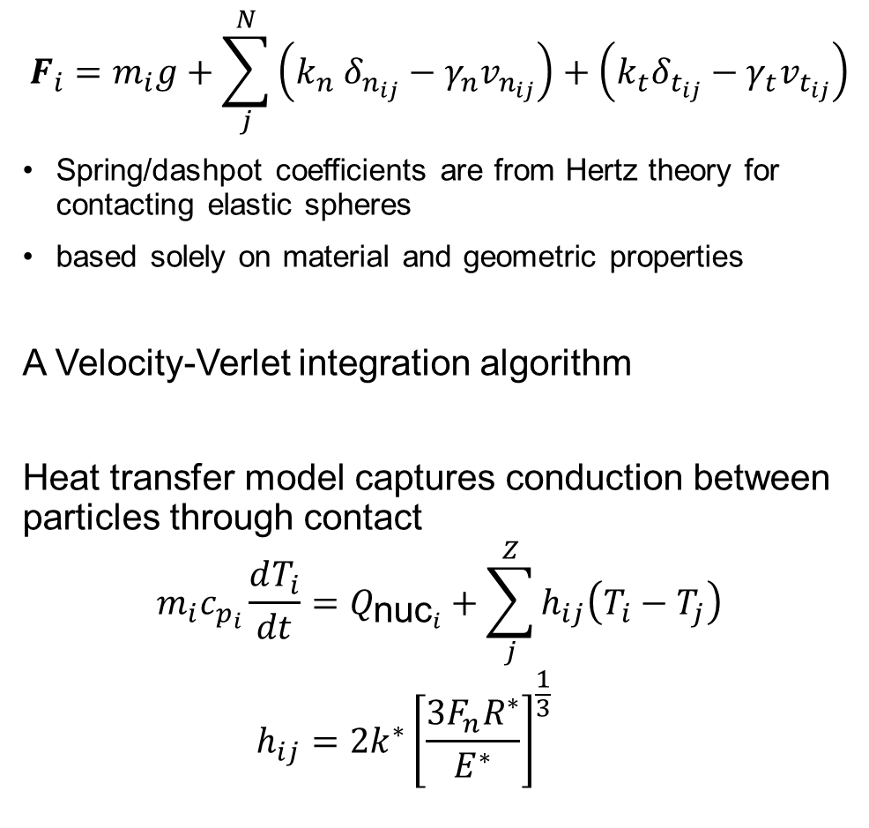
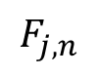
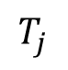
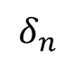
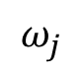
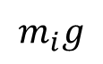
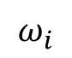
Transient Discrete Element Method
$$F_{i}=m_{i}g+\sum_{j}^{N}{\left(k_{n} δ_{n_{ij}}−γ_{n}v_{n_{ij}}\right)+\left(k_{t}δ_{t_{ij}}−γ_{t}v_{t_{ij}}\right)}$$
Spring/dashpot coefficients are from Hertz theory for contacting elastic spheres
based solely on material and geometric properties
A Velocity-Verlet integration algorithm
Heat transfer model captures conduction between particles through contact
$$m_{i}c_{p_{i}}\frac{dT_{i}}{dt}=Q_{{\text{nuc}}_{i}}+\sum_{j}^{Z}{h_{ij}\left(T_{i}−T_{j}\right)} \\ h_{ij}=2k^{∗}{\left[\frac{3F_{n}R^{∗}}{E^{∗}}\right]}^{\frac{1}{3}}$$
$$T_{j}$$
J
$$ω_{j}$$
$$δ_{n}$$
$$F_{j,t}$$
$$F_{j,n}$$
$$m_{j}g$$
Q
$$T_{i}$$
$$F_{i,n}$$
$$F_{i,t}$$
$$ω_{i}$$
I
$$m_{i}g$$

Slide 30
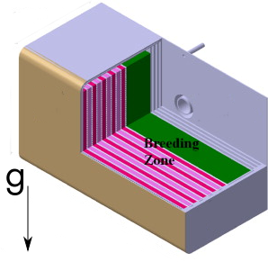
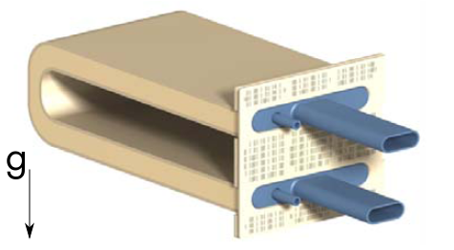
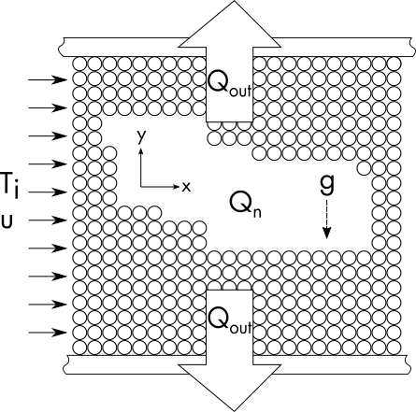
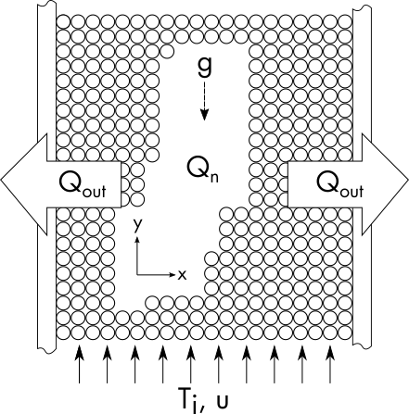
How does configuration effect temperature distribution when pebbles break?
~50 mm
20 mm
~50 mm
20 mm
$χ$ configuration
$ζ$ configuration

Slide 31
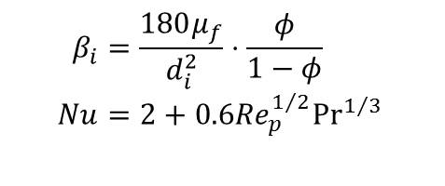
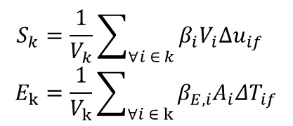
Multi-scale governing equations
Exchange coefficients
Pebbles (DEM)
$$m_{i}\frac{{du}_{i}}{dt}=m_{i}g+\sum_{j=1}^{Z}{F_{ij}}+β_{i}V_{i}{Δu}_{if} \\ m_{i}C_{i}\frac{dT_{i}}{dt}=Q_{n,i}+\sum_{j=1}^{Z}{Q_{ij}}+h_{i}A_{i}ΔT_{if}$$
Helium (volume-averaged CFD)
$$\frac{∂\left(ε_{k}ρ_{f}\right)}{∂t}+∇⋅\left(ε_{k}ρ_{f}u_{f}\right)=0 \\ \frac{∂\left(ε_{k}u_{f}\right)}{∂t}+∇⋅\left(ε_{k}u_{f}u_{f}\right)=−\frac{ε_{k}}{ρ_{f}}∇p_{f}+∇⋅\left({ν_{f}ε}_{k}∇u_{f}\right)−\frac{S_{k}}{ρ_{f}} \\ \frac{∂\left(ϵ_{k}T_{f}\right)}{∂t}+∇⋅\left(ϵ_{k}u_{f}T_{f}\right)=∇⋅\left(α_{f}ϵ_{k}∇T_{f}\right)−\frac{E_{k}}{ρ_{f}C_{f}}$$
$$β_{i}=\frac{180μ_{f}}{d_{i}^{2}}⋅\frac{φ}{1−φ} \\ Nu=2+0.6{Re}_{p}^{1/2}{Pr}^{1/3}$$
$$S_{k}=\frac{1}{V_{k}}\sum_{∀i ∈ k}{β_{i}V_{i}{Δu}_{if}} \\ E_{k}=\frac{1}{V_{k}}\sum_{∀i ∈ k}{β_{E,i}A_{i}{ΔT}_{if}}$$
More details of numerical method:
Van Lew, J. T., Ying, A., & Abdou, M.
http://doi.org/10.13182/FST14-937
DEM material implementation models:
Van Lew, J. T., Park, Y.-H., Ying, A., & Abdou, M.
http://doi.org/10.1016/j.fusengdes.2015.06.012

Slide 32
Granular fragmentation modeling
Several approaches used in studies at KIT for broken pebble modeling
Reduced Young’s modulus
Reduced radius
Previous approach from UCLA had the broken pebbles `deleted’
New approach considers fragmentation and resettling
Uncoupled fragmentation impact from fragmentation predictions
$\frac{r_{c}}{r}=0.352$, $N_{c}=23$
$\frac{r_{c}}{r}=0.2$, $N_{c}=125$

Slide 33
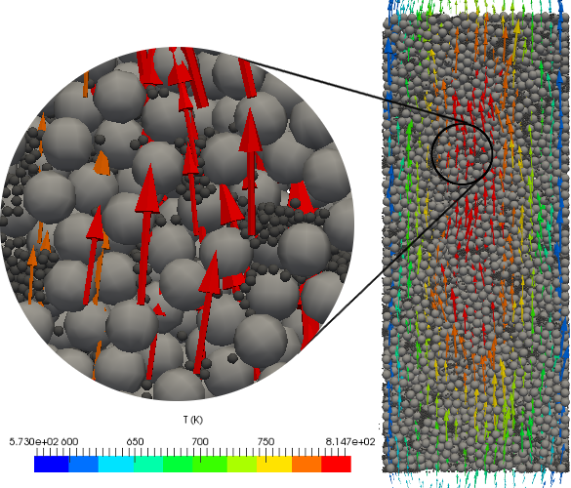
Example of flow field through beds
Helium purge gas ‘regulates’ the temperature of fragments to equilibrate with nearby pebbles

Slide 34
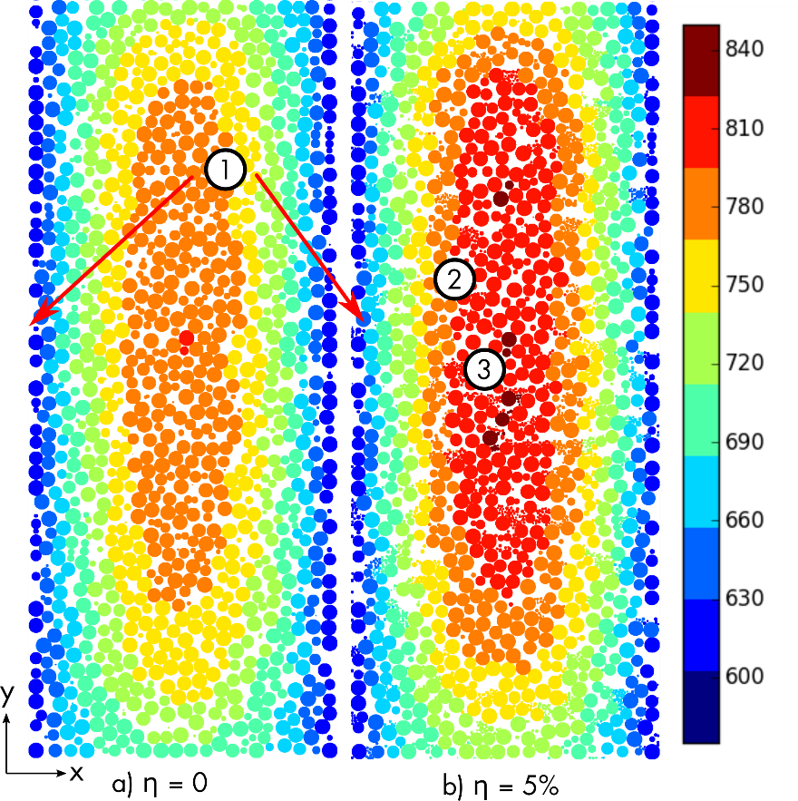
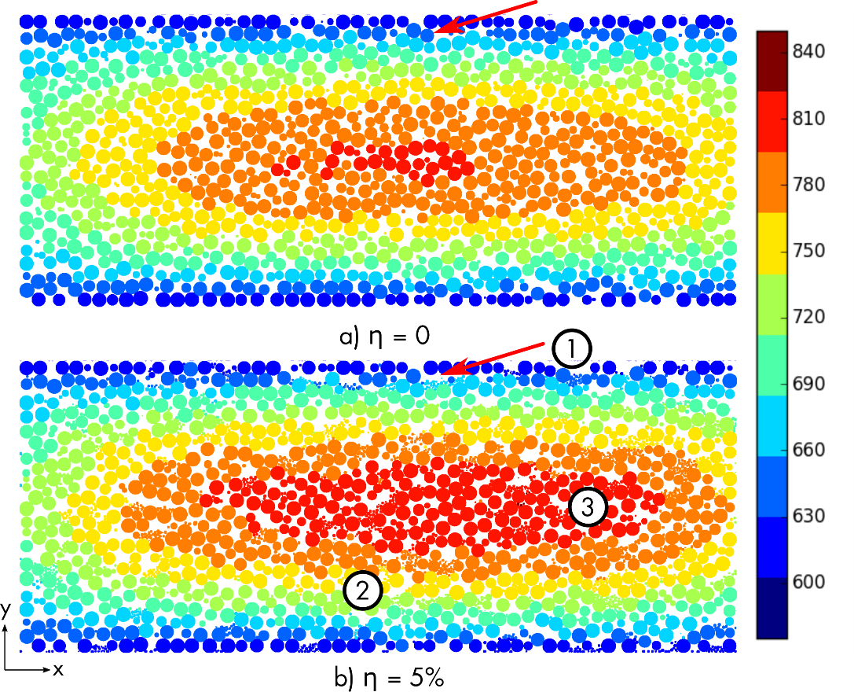
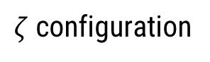
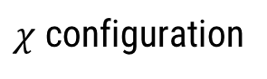
Pebble bed cross-sections
Identify several zones for discussion
$χ$ configuration
$ζ$ configuration

Slide 35
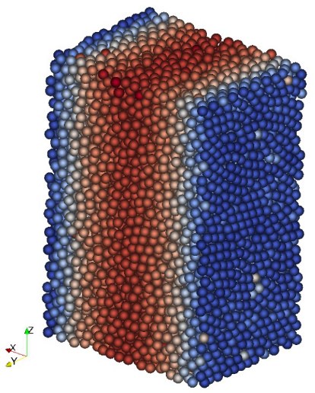
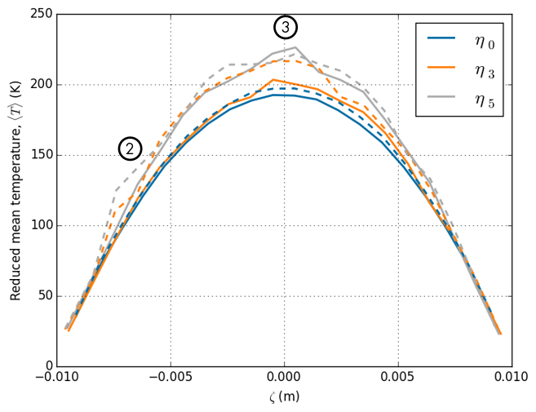




Reduced Mean Temperature Profiles
$$\left\langle T\right\rangle =\frac{1}{V_{n}}\sum_{j}^{n}{\left(T_{j}−T_{w}\right)V_{j}}$$
Calculated for n pebbles in volume of slice thickness $Δζ$
Asymmetric lump in $ζ$
High peak in $χ$
Solid line = $χ$ configuration
Dashed line = $ζ$ configuration

Slide 36

Maximum Temperature Rise
Many loose fragments in $χ$ cause ~25% jump in T
Only 10% increase in maximum T

Slide 37

Local packing fraction changes due to fragment settling

Slide 38






Example of travel of fragments for case $r_{2}^{∗},φ_{64}$ with 5% crushed pebbles
$3×{10}^{−3}$ m
final
$1×{10}^{−6}$ m
initial

Slide 39


Vertical travel of fragments for case $r_{2}^{∗},φ_{64}$ with 5% crushed pebbles
~60% of fragments travel less than 1 mm
~8% of fragments travel more than 2 mm

